Slide 1


Slide 2
Advantages of AlmaLinux
Free & Stable
Enterprise Ready
Long Term Support
Secure
Easy Installation
RHEL Compatible
Ideal for Servers & Labs
Simple & Powerful
Notes:
Summarize benefits and production usage.

Slide 3
AlmaLinux Installation
Step-by-Step Practical Approach
Lab Session

Slide 4
Supported Architecture
Supported Architectures
AlmaLinux is available for:
  x86_64 (most common for PCs and servers)
  ARM64 (used in ARM-based systems)
  ppc64le (Power architecture)
  s390x (IBM Z systems)
It also supports both:
  BIOS
  UEFI firmware

Slide 5
AlmaLinux Installation
Free & Open Source Linux Distribution
RHEL Compatible
Enterprise Grade OS
Community Driven

Slide 6
System Requirements
2 Core CPU
2 GB RAM (4 GB Recommended)
20 GB Disk Space
Bootable USB
Notes:
Discuss minimum vs recommended requirements for lab environment.

Slide 7
Downloading AlmaLinux
Visit https://almalinux.org
Download AlmaLinux 9 ISO
Choose x86_64 Architecture
Notes:
Show website during live demo if possible.

Slide 8
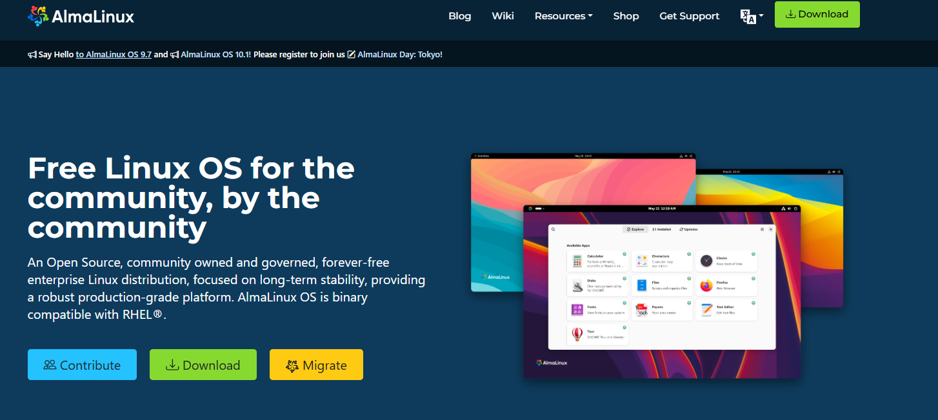
Downloading AlmaLinux
Notes:
Show website during live demo if possible.

Slide 9
Creating Bootable USB
Use Rufus / Balena Etcher
Select ISO
Start Process
Boot from USB
Notes:
Explain BIOS/UEFI boot selection briefly.

Slide 10
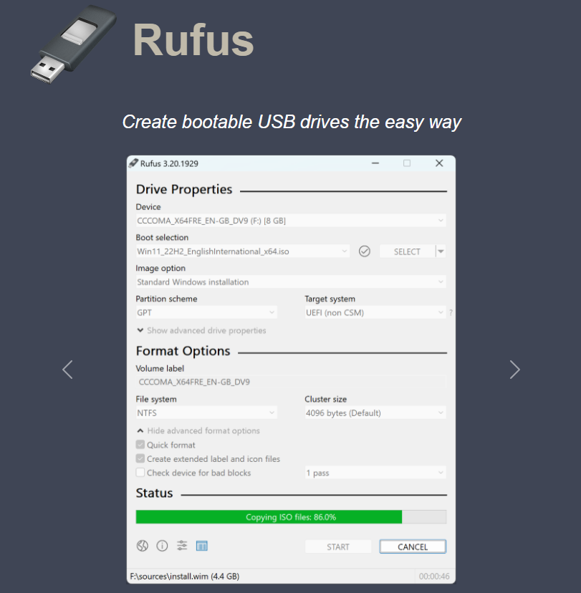
Rufus download https://rufus.ie/en/

Slide 11
Boot Menu
Install AlmaLinux
Test Media & Install
Troubleshooting
Notes:
Explain installer options before selecting install.

Slide 12
Installation Flow Diagram
BIOS →
Boot USB →
      Installer → Partition →
Configure →
Install →
Reboot →
Login
Notes:
Explain flow visually step-by-step.

Slide 13
Installation Screen
Language & Keyboard
Software Selection
Installation Destination
Network & Hostname
Notes:
Walk through each configuration item carefully.

Slide 14
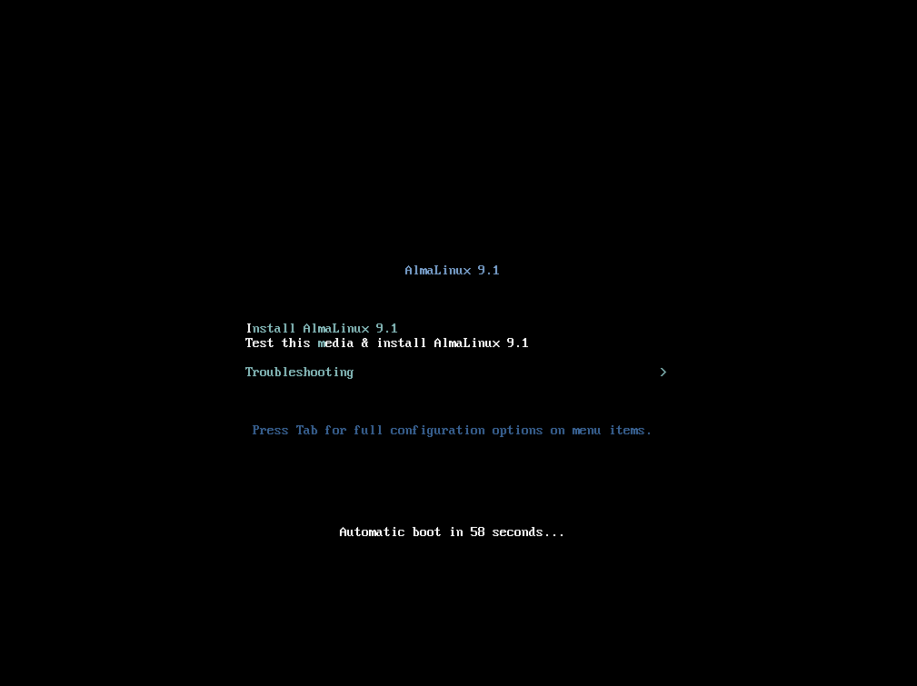
Installation screen

Slide 15
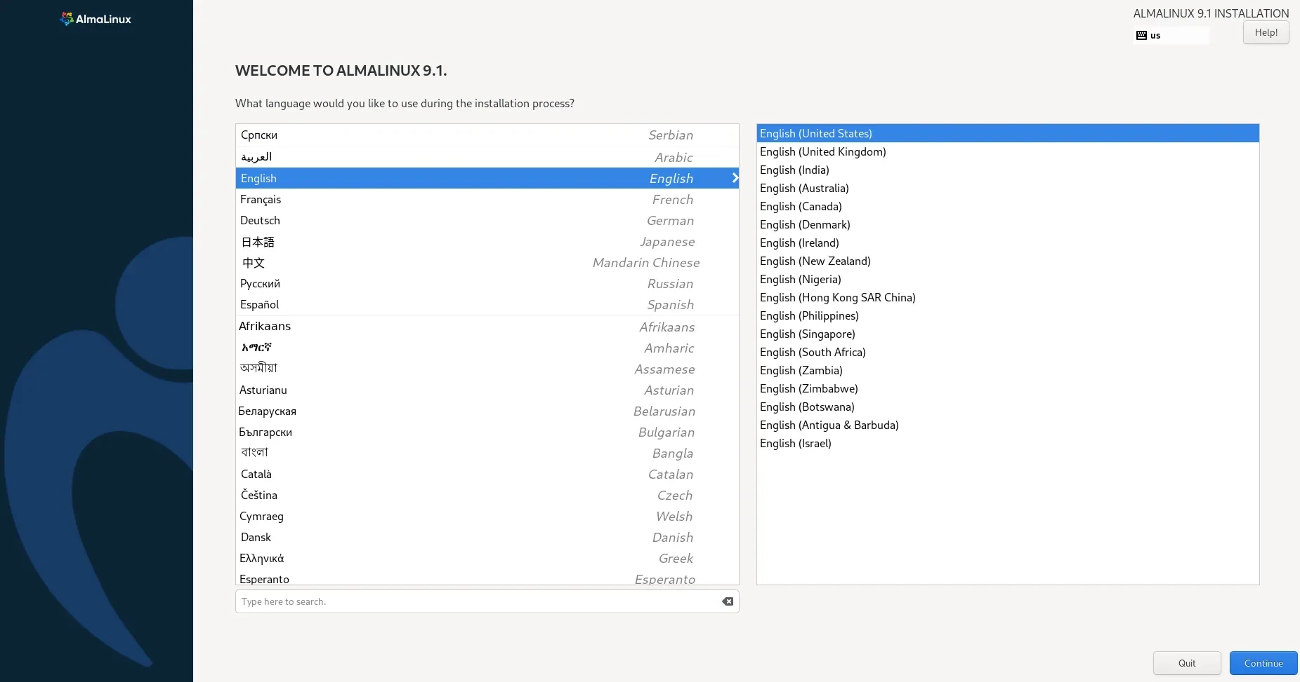
Installation screen

Slide 16
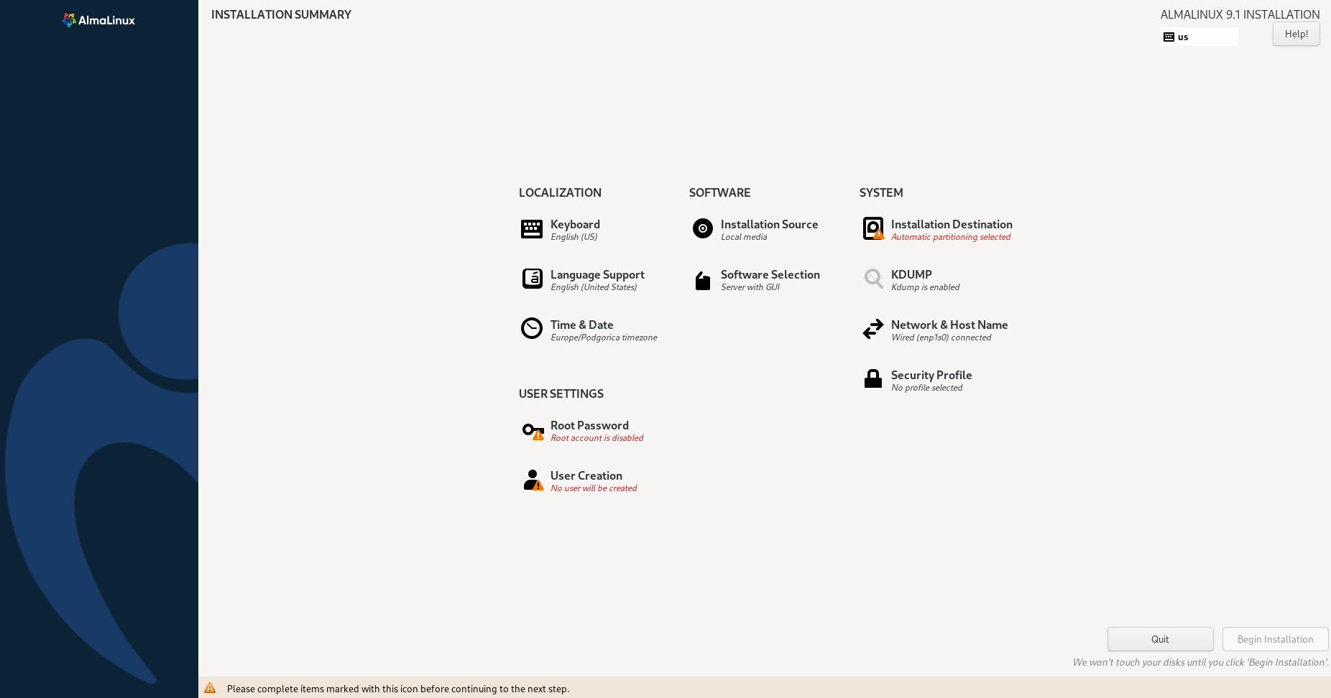
Installation screen

Slide 17
Software Selection
Server with GUI – for students and desktops
Minimal Install – for servers
Manual selection – for advanced users
Notes:
Recommend Server with GUI for beginners.

Slide 18
Disk Partitioning
Automatic Partitioning
Manual Partitioning
/ - OS files
/home - User home directory
swap - Virtual Memory
/boot - OS boot files
/usr - Library and system files
/var - log files and others
Notes:
Explain purpose of each partition.

Slide 19
Network Configuration
Enable Ethernet
Set Hostname
Configure Static IP (Optional)
Notes:
Explain importance of hostname and IP addressing.

Slide 20
User Creation
Set Strong Root Password
Create Standard User
Add to Wheel Group (Optional)
Notes:
Discuss security best practices.

Slide 21
Post Installation
dnf update –y
cat /etc/os-release
ip a
Notes:
Demonstrate updating system and checking OS version.

Slide 22
Firewall Configuration
systemctl status firewalld
firewall-cmd --add-port=80/tcp –permanent
firewall-cmd --reload
Notes:
Explain basic firewall management.

Slide 23
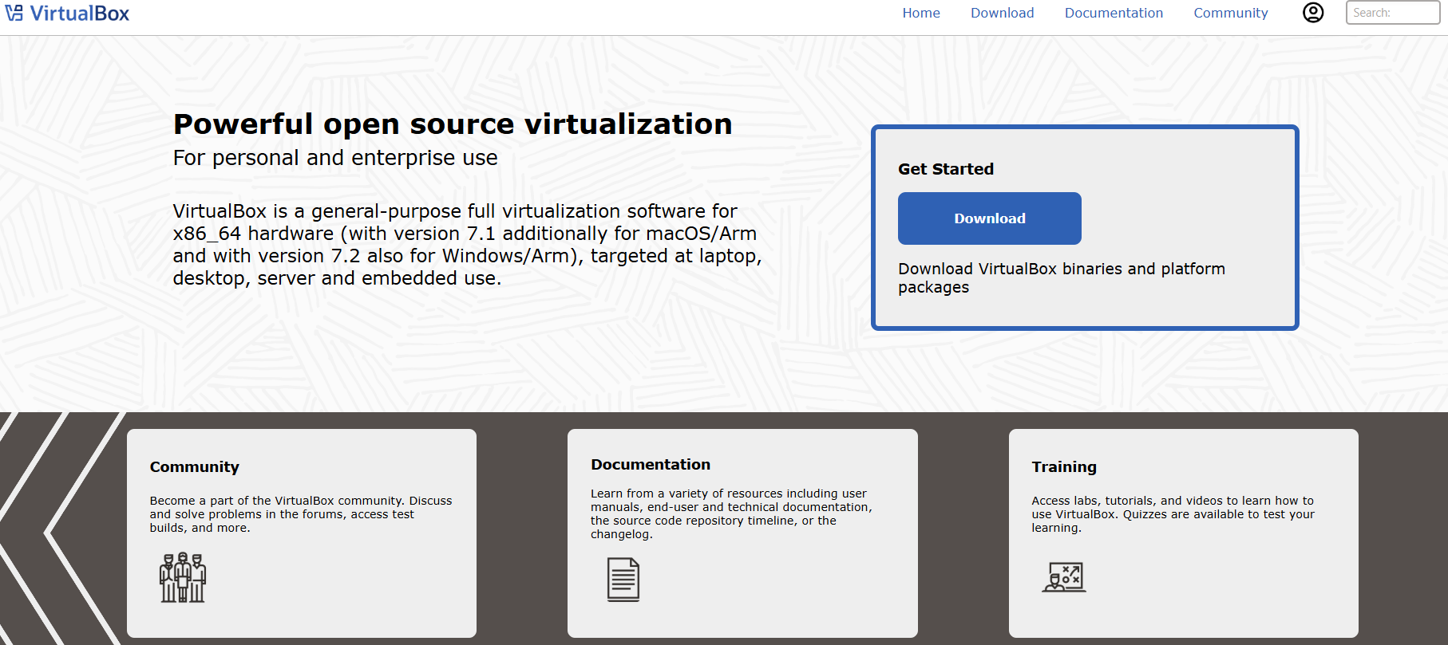
Virtualbox https://www.virtualbox.org/

Slide 24
Installing Apache (Example Lab)
dnf install httpd –y
systemctl start httpd
systemctl enable httpd
Notes:
Show how to deploy a simple web server.

Slide 25
Lab Exercise 1
Install AlmaLinux in VM
Create User Account
Update System
Check IP Address
Notes:
Allow students 20 minutes hands-on practice.

Slide 26
Lab Exercise 2
Install Apache
Start & Enable Service
Open Port 80 in Firewall
Verify via Browser
Notes:
Students test using browser with server IP.

Slide 27
Troubleshooting
USB Not Booting
No Network
Disk Not Detected
Low RAM Issues
Notes:
Discuss common student mistakes.

